Slide 1

Hotel Booking Demand Prediction
Presented by: Group 8 (B)
Chen Ying G2502026L
Geyue You G2501502A
Seah Ming Yang G2500454B
Lan Xiaolu G2500419F
Timothy Hartanto G2500347D

Slide 2
Agenda
1. Background
2. Business Understanding
3. Exploratory Data Analysis
4. Machine Learning Modelling
5. Recommendation & Summary

Slide 3

1. Background
Presented by: Chen Ying

Slide 4



Background
01
02
03
Industry Growth &
Intensified Competition
Challenge
Opportunity
Driven by rising travel demand and expansion of online booking platforms
Pushing hotels to optimize operations to maximize revenue
Managing booking cancellations which can lead to revenue loss
Machine learning predicts cancellations
Data-driven revenue management
Presented by: Chen Ying

Slide 5
2. Business Understanding
Presented by: Chen Ying

Slide 6
Revenue Loss from Unpredictable Booking Cancellations
Business Logic
Business Impact
Hotel managers aim to maximize revenue and resource efficiency by accurately forecasting guest demand.
However, bookings are accepted without a reliable data-driven mechanism to predict whether they will be canceled.
As a result, hotels often face unexpected cancellations and no-shows, leading to:
lost revenue
inefficient staff allocation
wasted resources
Presented by: Chen Ying

Slide 7
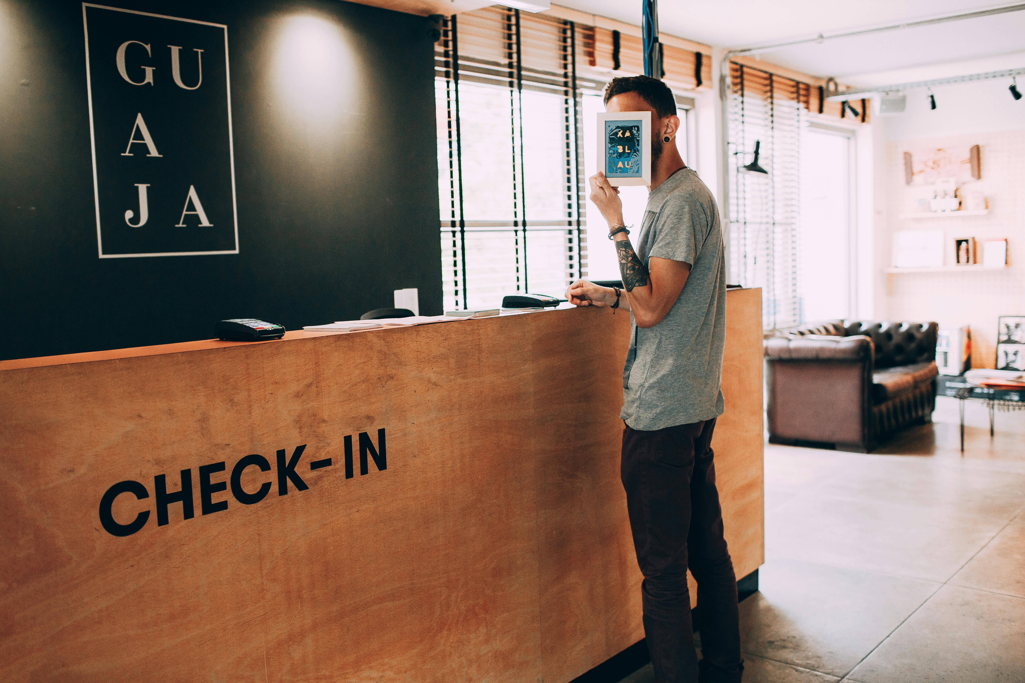

Goals
01
02
Identify Booking Cancellations
Build a reliable model to estimate the likelihood of booking cancellations so hotels can take proactive actions.
Maximize Revenue
Anticipate future booking levels to optimize room allocation, staffing, and pricing strategies.
Presented by: Chen Ying

Slide 8
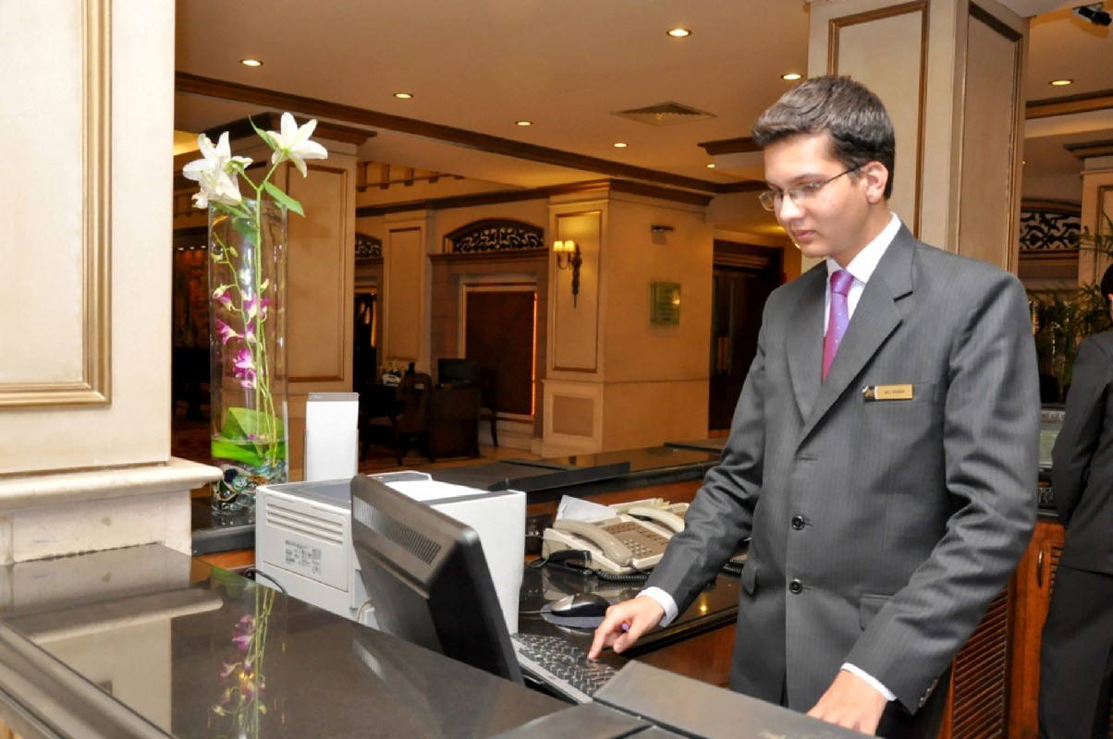
Primary Stakeholder
Hotel Revenue Manager
Presented by: Chen Ying
Notes:
The analysis and subsequent ML model is primarily for the benefit of hotel revenue manager who is concerned with maximizing the day-to-day revenue that the hotel generates, which is primarily through booking

Slide 9





Analytic Approach
Data Preparation
Exploratory Data Analysis
Find Benchmark Model
Tuning
Evaluation
Presented by: Chen Ying

Slide 10
Model Evaluation
Checked-In
Predicted
Analytical Focus
Checked-In
Cancelled
33% of bookings are canceled → cancellations are frequent and costly.
Emphasis will be on lowering False Negatives (Predicting that a guest checks in, when in fact the guest cancels)
Lower False Negatives ensures fewer cancellations are missed, reducing lost revenue.
Actual
True Positive
False Positive
Cancelled
False Negative
True Negative
Presented by: Geyue You

Slide 11
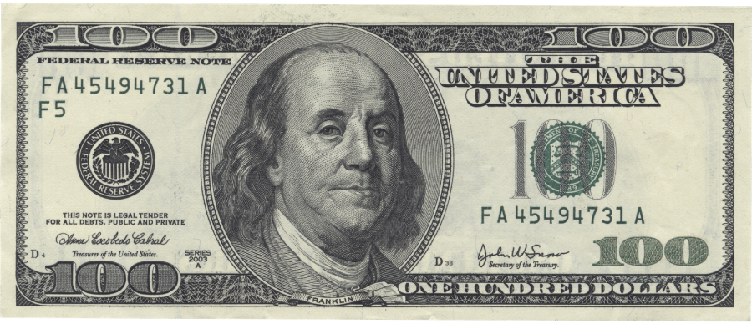
Overbooking Vs Underbooking
Why does false booking checked-in hurt more than false cancellation?
Assuming 25% FP rate ( Predicted cancel but guest shows up )
False Cancellation Cost
(False Positive)
Predicted cancel but guest show-up -> room is sold last minute with heavily discounted price
False Checked-In
Cost
(False Negative)
Predicted show-up but guest cancels → full revenue loss
Losing a booking is over four times more costly than overbooking.
A data-driven strategy is needed to predict customers at high risk of cancellation to enable the hotel revenue manager to take measures in optimizing room allocation and minimizing revenue loss.
Presented by: Geyue You

Slide 12
3. Exploratory Data Analysis
Presented by: Geyue You

Slide 13
Data Preparation
Data Collection
Data Cleaning
Data Transform
Data Splitting
Analysis & Modelling
Presented by: Geyue You

Slide 14
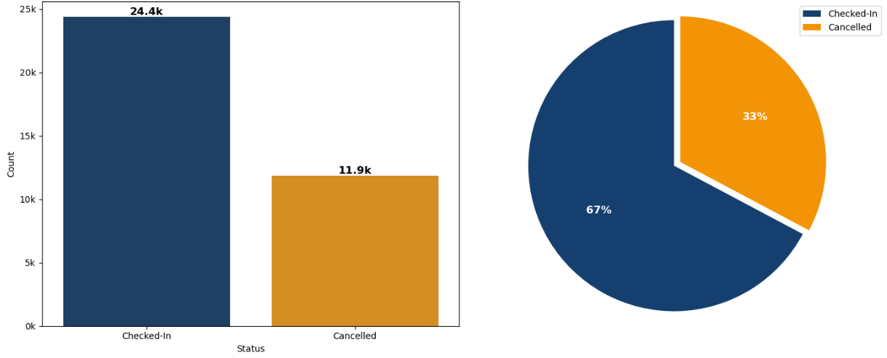
Booking Cancellation Distribution
Imbalanced target variable can lead to:
Biased predictions
Inflated accuracy metrics
Poor model performance on critical but underrepresented cases.
Presented by: Geyue You

Slide 15
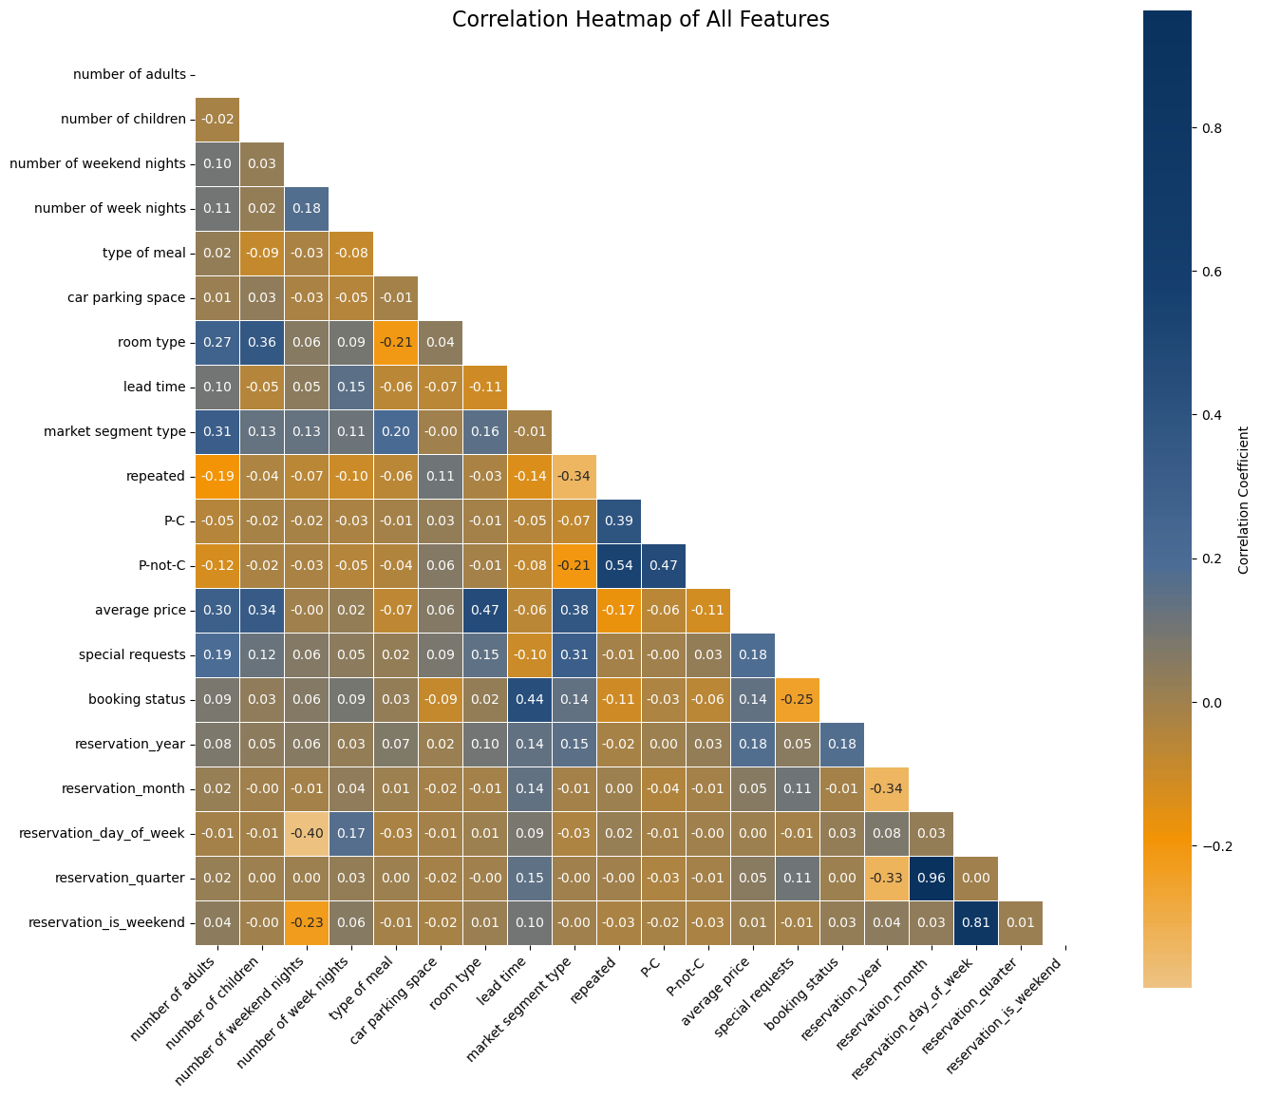
Key cancellation Drivers
Presented by: Geyue You
Notes:
Using this correlation heatmap pyramid, we can filter features which are more strongly correlated to the target label (booking status)

Slide 16
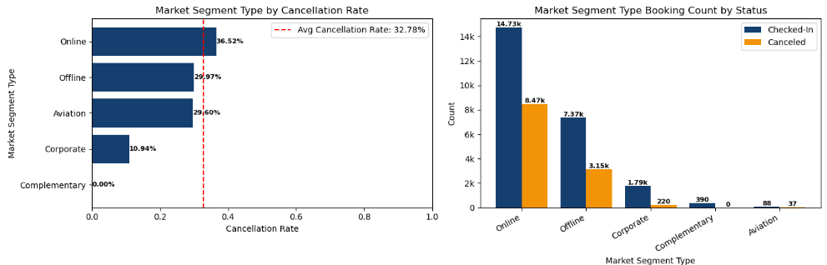
Cancellation Rate by Market Segment
The majority of hotel bookings are cancelled via online platforms, with a cancellation rate of 36.52%.
Presented by: Seah Ming Yang

Slide 17
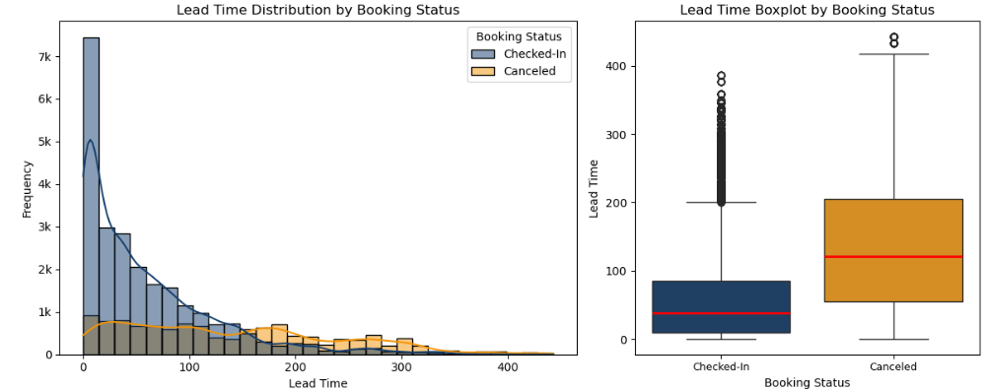
Lead Time on Booking Cancellation
Cancelled Bookings
Lead Time
Presented by: Seah Ming Yang
Notes:
Right-skewed

Slide 18
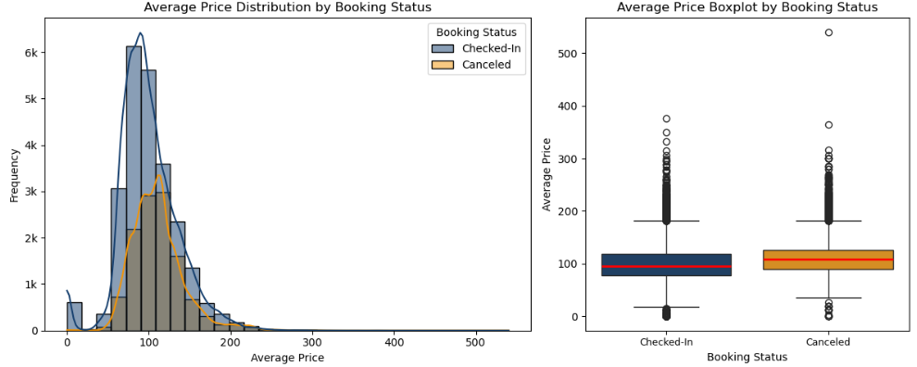
Average Price on Booking Cancellation
Average Price
Cancelled Bookings
Presented by: Seah Ming Yang
Notes:
Right-skewed

Slide 19
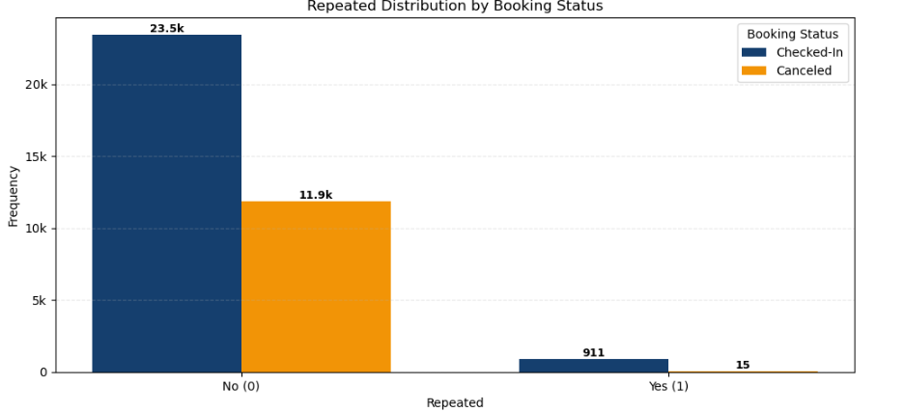
Repeated Customers on Booking Cancellation
33.6% of new customers cancelled bookings.
1.6% of repeated customers cancelled bookings.
Presented by: Seah Ming Yang

Slide 20
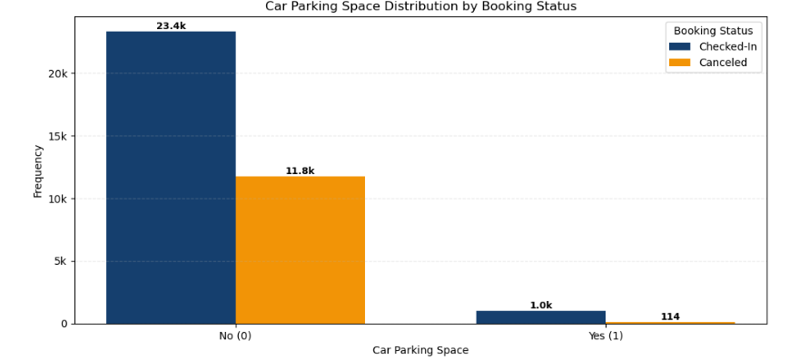
Parking space on Booking Cancellation
33.5% cancellation rate with no parking space.
10% cancellation rate with parking space.
Presented by: Seah Ming Yang

Slide 21
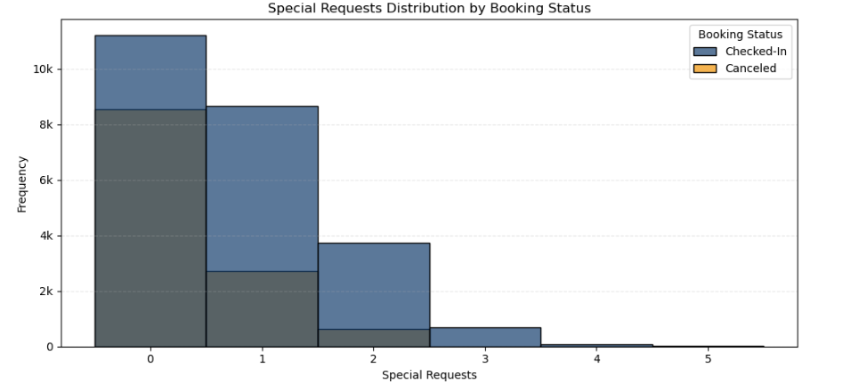
Special Requests on Booking Cancellation
Guests who make more special requests are generally more likely to follow through with their stay.
Presented by: Lan Xiaolu

Slide 22
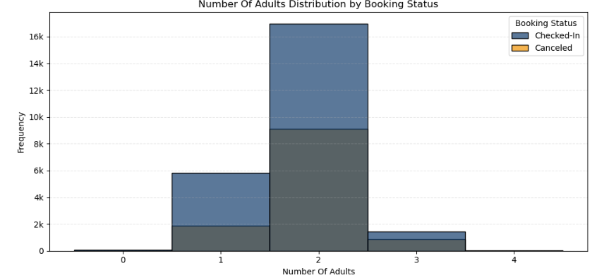
Number of Adults on Booking Cancellation
Bookings made for 2–3 adults show a higher likelihood of cancellation.
Presented by: Lan Xiaolu

Slide 23
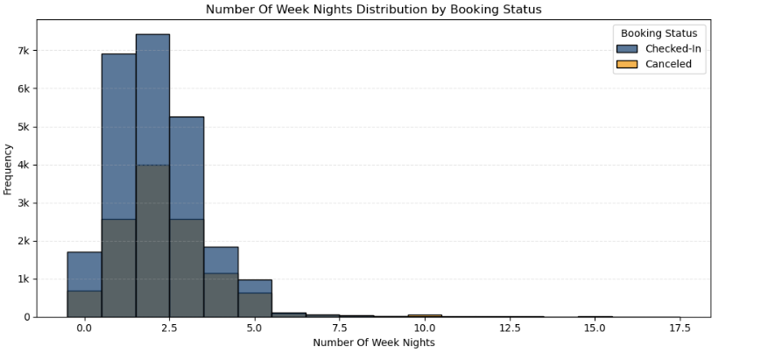
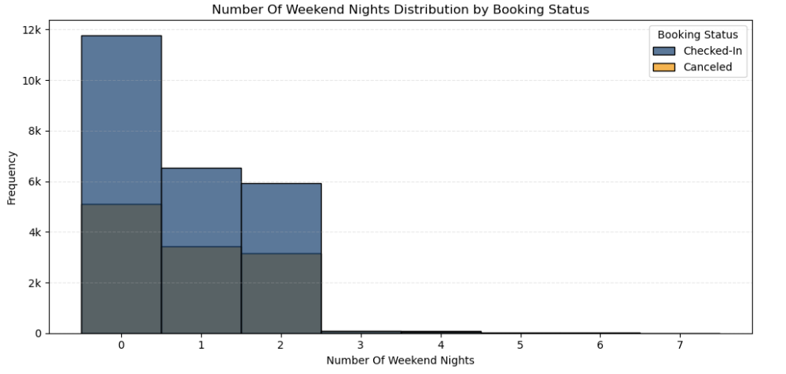
Length Of Stay on Booking Cancellation
Nights of stay
Cancelled Bookings
Presented by: Lan Xiaolu

Slide 24
4. Machine Leaning Modelling

Slide 25



Three Steps of ML Modelling
Initial Model Comparison
Hyperparameter
Tuning
Adjust Threshold for Business Impact
Compare 5 different classification algorithms.
Select Random Forest and XGBoost as leading models.
Fine-tune to ensure accuracy and consistency.
Confirm Random Forest being the most reliable model.
Adjust the threshold of the model to catch as many false negatives as possible.
Presented by: Lan Xiaolu

Slide 26

And the best model is ...
Random Forest!
Presented by: Lan Xiaolu

Slide 27
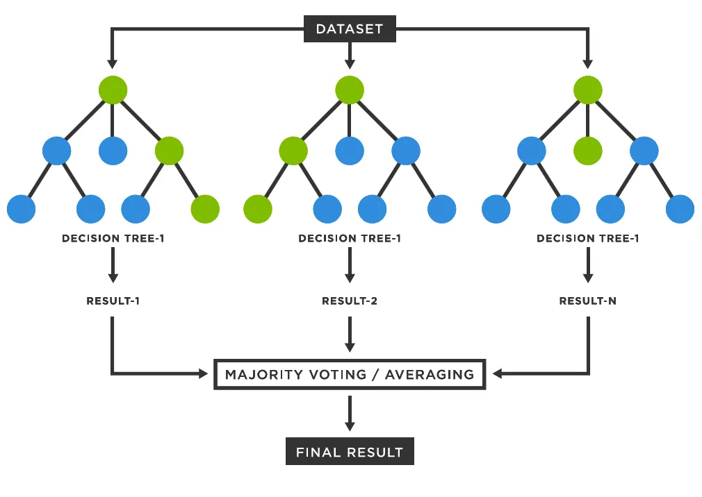
How Does It Work?
Presented by: Timothy Hartanto

Slide 28
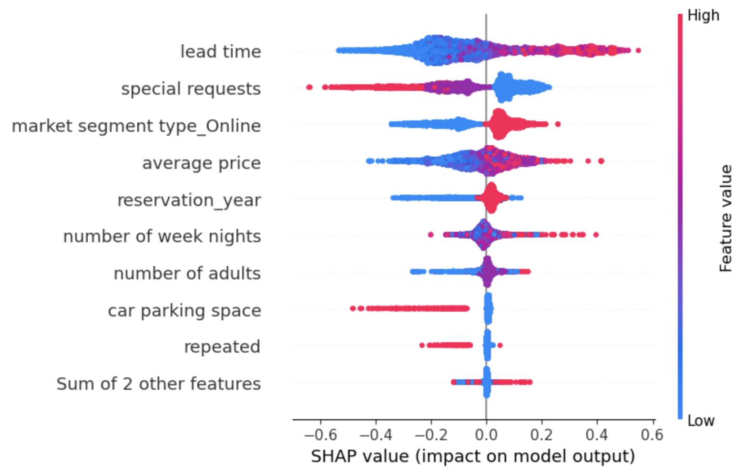


Key Drivers of Booking Cancellations
Feature Importance
Feature Impact
Factors increasing cancellation risk
Factors reducing cancellation risk
Longer lead time
Higher average price
Online booking channel
Special requests
Returning/repeated guests
Car parking space requested
Lead time and price are the strongest risk factors, while guest engagement signals (requests, repeat stays) reduce cancellations.
Presented by: Timothy

Slide 29



Business Outcome Evaluation
No Model
After Tuning &
Threshold Adjustment
Performance of the Model
Checked-In
Predicted
Checked-In
Predicted
Checked-In
Cancelled
Checked-In
Cancelled
69.79%
predicted cancellations identified
Actual
Actual
4,873
0 (0.0%)
3,943
930 (12.8%)
Cancelled
Cancelled
90.37%
real cancellations
identified
2,377 (32.8%)
0
229 (3.2%)
2,148
Business Costs
 | FP Counts | FN Counts | FP Cost | FN Cost | Total Cost | % Cost Saved vs No-Model
No-Model | 0 | 2,377 | $0 | $852,276 | $852,276 | 0%
After Tuning & Threshold Adj. | 930 | 229 | $82,266 | $76,855 | $159,121 | 81%
Cost Information
ADR: $120/night
Avg Stay: 2 nights
False Cancellation Cost: 25% of ADR x nights
Only room revenue considered
Presented by: Timothy Hartanto

Slide 30
5. Recommendation and Summary

Slide 31
Model Deployment
Model Deployment
Guest Arrival
Payment / Deposit
Customer Booking
System Confirmation
Resource Allocation
Presented by: Timothy Hartanto
Notes:
We recommend that the ML model is deployed before booking is confirmed to safeguard the hotel from false booking activities….

Slide 32
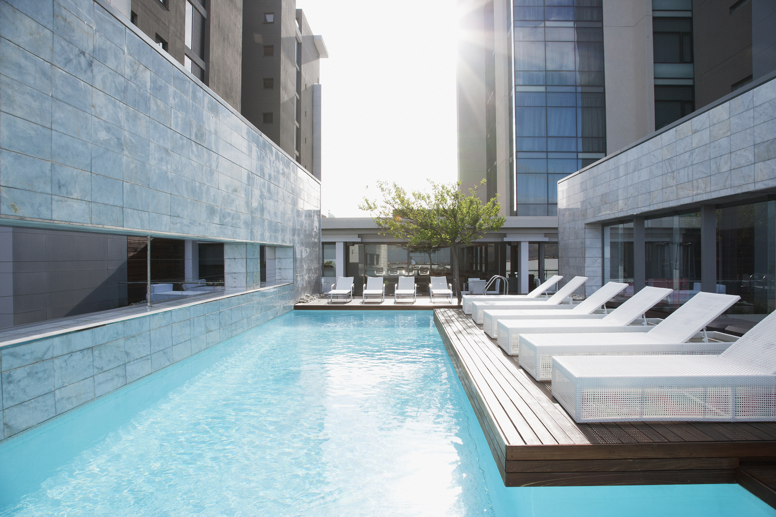
Business Recommendation
Prompt for special requests during booking
Show open hotel rooms for booking closer to check-in date
Increasing chances and number of special requests will decrease the cancellation rate.
Reducing lead time hence decreasing the cancellation rate.
Lower booking prices closer to check-in date.
Implement strategies to promote short-term stay
Reducing booking prices in conjunction with lead time will further decrease cancellation rate.
Retaining / prioritizing / attracting guests who are more likely to commit to a short duration of stay.
Presented by: Timothy Hartanto
Notes:
Based on the dataset, we recommend the following points for revenue manager of this hotel….

Slide 33
Thank you
for your attention.

Slide 34
Business Recommendation
01
02
03
Prompt for any special requests when guests are booking their rooms
Show open hotel rooms for booking closer to the guest’s check-in date
No refund upon cancellation policy
HEHEHEHEEEEE
Increasing chances and number of special requests will decrease the cancellation rate.
Reducing lead time hence decreasing the cancellation rate.

Slide 35
Background
Over the past decade, the hotel industry has experienced rapid growth, driven by increasing domestic and international travel, rising disposable incomes, and the expansion of online booking platforms. This growth, however, has also intensified competition, pushing hotels to optimize operations, enhance customer experiences, and implementing strategies to maximize revenue.
One persistent challenge in the industry is managing booking cancellations, which occurs when customers change or cancel their reservations before arrival, significantly disrupting hotel operations and can lead to revenue loss.
By analyzing hotel booking data—including customer demographics, reservation details, and outcomes—data scientists can use machine learning to predict cancellations. This approach transforms traditional guesswork into a data-driven process, helping hotels identify key factors affecting bookings and optimize revenue management strategies with measurable, actionable insights..

Slide 36
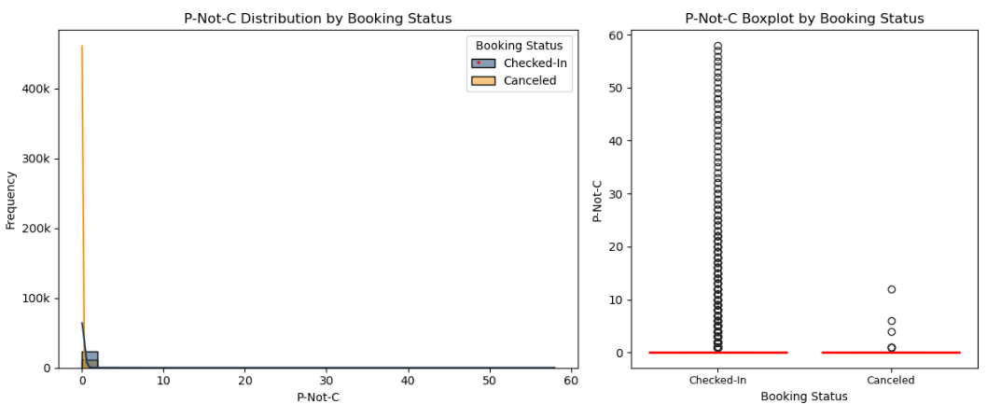
P-not-c (I think we don’t have to show this)

Slide 37
AI Model for Predicting Booking Cancellations
Best-performing model: Random Forest
Random Forest and XGBoost as the leading models.
Business Value of Random Forest
Rank | Classifier | Resampler | K | mean_score | std_score | mean_time
1 | RandomForest | UnderSampler | 11 | 0.830086 | 0.006696 | 0.204012
2 | RandomForest | UnderSampler | 9 | 0.827155 | 0.005393 | 0.217898
3 | XGB | UnderSampler | 11 | 0.820562 | 0.005382 | 0.056007
4 | XGB | UnderSampler | 9 | 0.818887 | 0.004377 | 0.075310
... | ... | ... | ... | ... | ... | ...
69.79% accuracy of predicted cancellations
Subsequent fine-tuning confirmed Random Forest as the most reliable model.
Rank | Classifier | Resampler | K | mean_score | std_score | mean_time
1 | RandomForest | UnderSampler | 11 | 0.834917 | 0.007944 | 0.159441
2 | RandomForest | UnderSampler | 9 | 0.834917 | 0.007944 | 0.172090
3 | RandomForest | UnderSampler | 11 | 0.834352 | 0.006373 | 0.406688
4 | RandomForest | UnderSampler | 9 | 0.834352 | 0.006373 | 0.415300
... | ... | ... | ... | ... | ... | ...
90.37% cancellations identified
*Candidate Models: Logistic Regression, Decision Tree, XGBoost, LightGBM, Random Forest

Slide 38
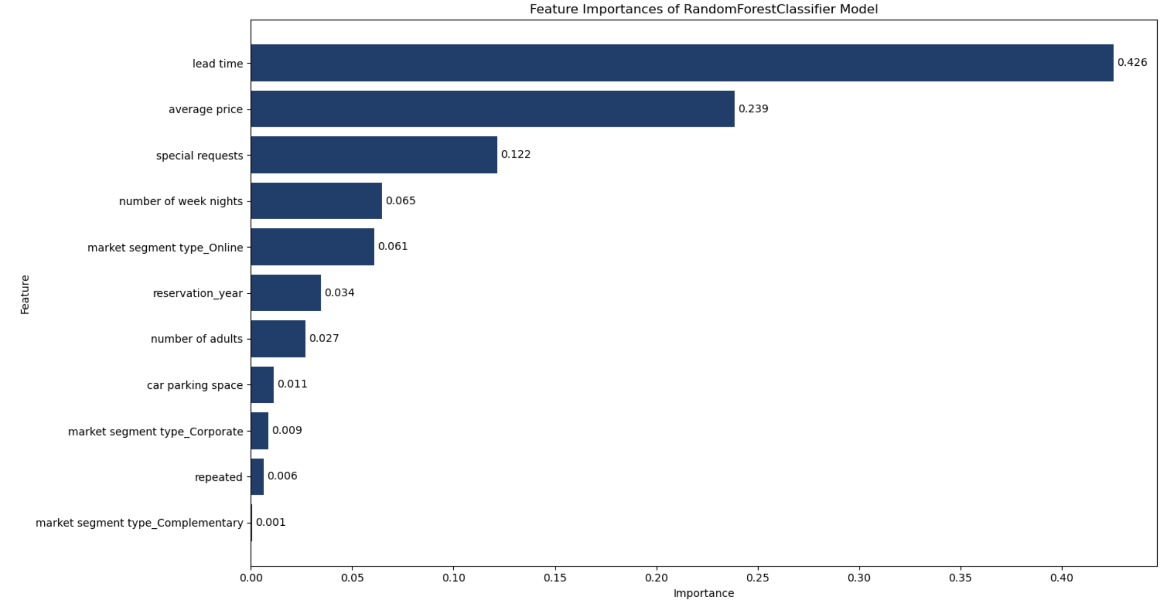
Business Recommendation
Prompt guests for any special requests when booking their rooms
Increasing car park size (not feasible)
Show open hotel rooms for booking closer to the guest’s check-in date.
4) Lower room price closer to the guest’s check-in date.
5) Pay a deposit for length of stay over 3 nights?
6) No refund on cancellation heheeeee:))

